Slide 1
Module C
Unit C2
Vocabulary
Language Functions
Speaking Activities
UTN FRVM Lic. Evangelina Cecchel - Lic. Bibiana Fernandez

Slide 2
Vocabulary:
Gerunds and Infinitives
UTN FRVM Lic. Evangelina Cecchel - Lic. Bibiana Fernandez

Slide 3
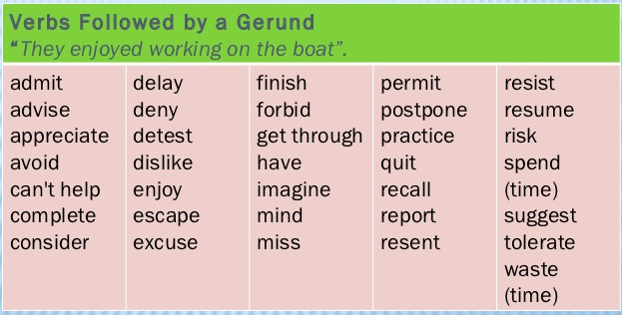

Slide 4
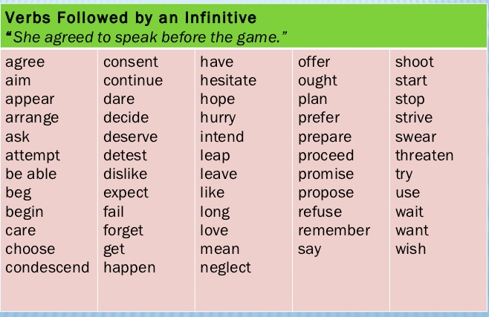

Slide 5
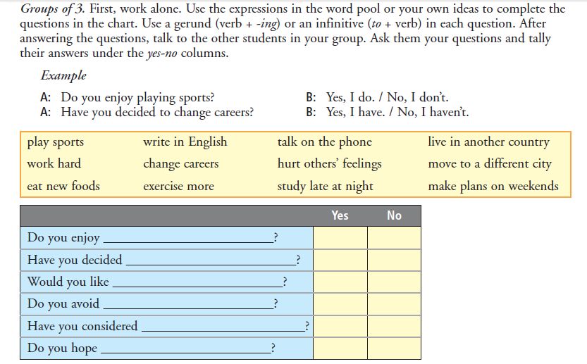
UTN FRVM Lic. Evangelina Cecchel - Lic. Bibiana Fernandez

Slide 6
Language Functions:
Expressing Purpose
UTN FRVM Lic. Evangelina Cecchel - Lic. Bibiana Fernandez

Slide 7
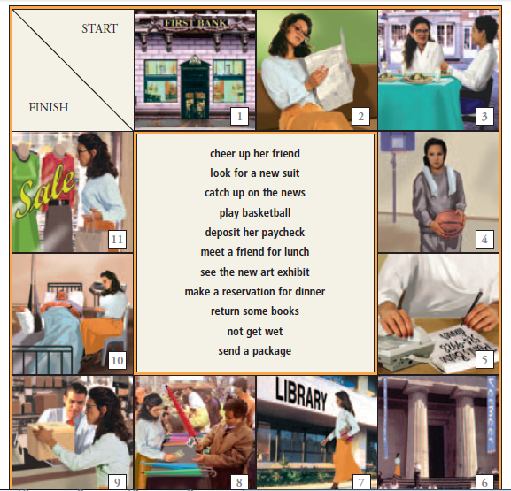
Activity: Did you go to any of these places? For what purpose?
Example
A: Why did you go to the bank?
B: I went to the bank to deposit a check.
UTN FRVM Lic. Evangelina Cecchel - Lic. Bibiana Fernandez

